Slide 1
Ai-Team 15
Startup Success Predection.
Mentor:DR.V.VENKATARAMANA.
Team Members:
1:A.AMOGH VARSH RAJU 19K41A0590
2:A.SAI KIRAN 19K41A0592
3: A.FATHIMA 19K41A04F1

Slide 2
CONTENT
Objective
Stake holders
Comparitive result analysis
Data insights
Application Demonstration
ML models
Conclusion & Future scope.

Slide 3
OBJECTIVE
The Main Objective of the Project is to build a regression model, that can predict the success rate of the startup by comparing the results and previous data of these.
Companies.
Startup’s.
Investments.
Funding.

Slide 4




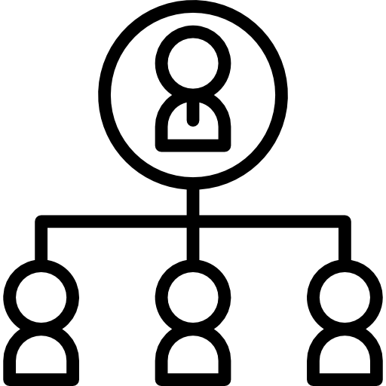

Stake holders
Investors
Creative Employees
The people who generally investin a startup just through pitching
Not only money lenders but also the people who want to work by knowing will they get paid.
Business holders
Events&Competetions
The new business people who are willing to estabish a new business in less time.
Startup event hosters can filter the startups in the comptetion.
Organizations
Founder
Other NGO organizations who generally donate for the startups.
The startup founder for himself can analyze whther how to get investment, he will fail or pass.

Slide 5
Data set insights
Marketing Labels
Founded at
Last funding at
Age First Funding
The number of marketing labels a company has
The year of the company was found at.
The time of the company when it received its last funding .
The age of the company when it received its first funding.
Age last funding
Age first Milestone
Participants
Top 500
Age of te company when it received its last funding.
Age of the company after it reached its first milestone.
The number of employees along with the founder and director within the company.
Is the company in top 500 list of existing companys or is it in the top 500 startups.

Slide 6
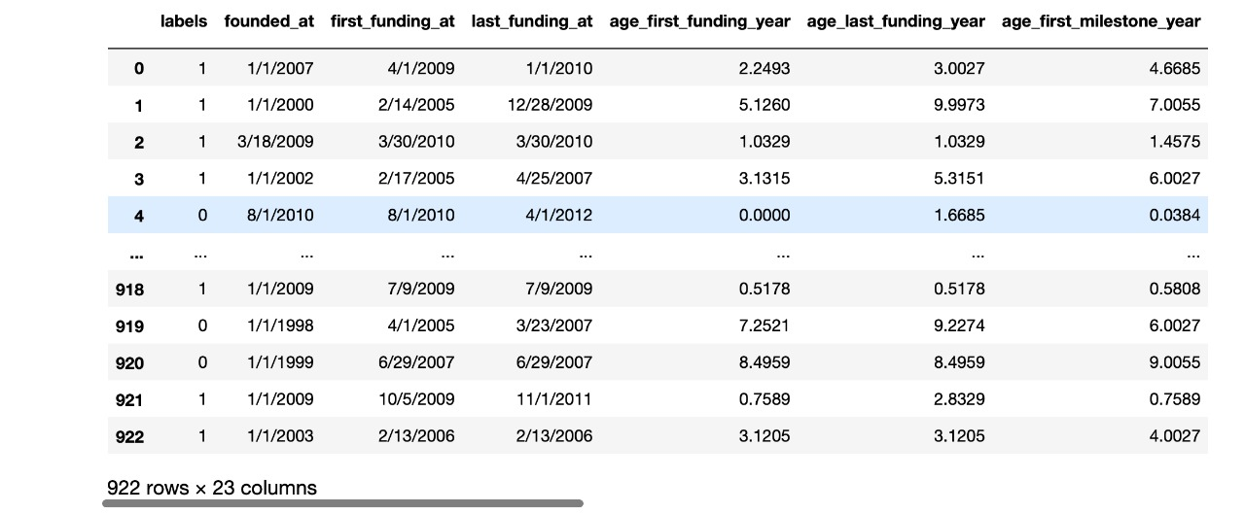
Data insights.
1
1
1
1
1
3
6

Slide 7
ML Models & Comparitive Results
ALGORITHM | ACCURACY RATE
KNN | 0.72(72%)
SVC | 0.70 (70%)
Decision Tree | 0.89(89%)
Random Forest | 0.9(90%)
Logistic regression | 0.9(90%)

Slide 8
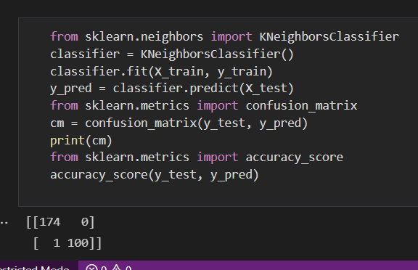
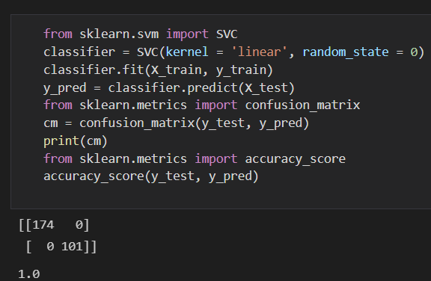
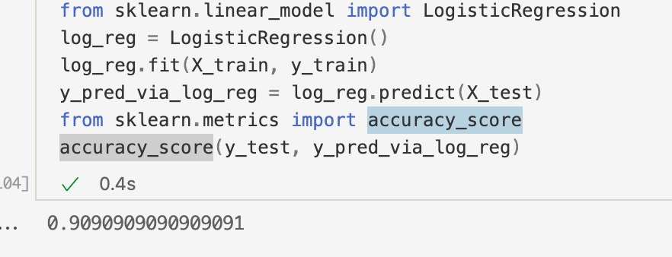
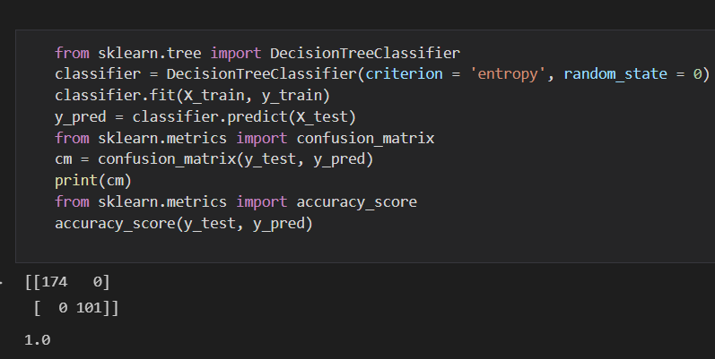
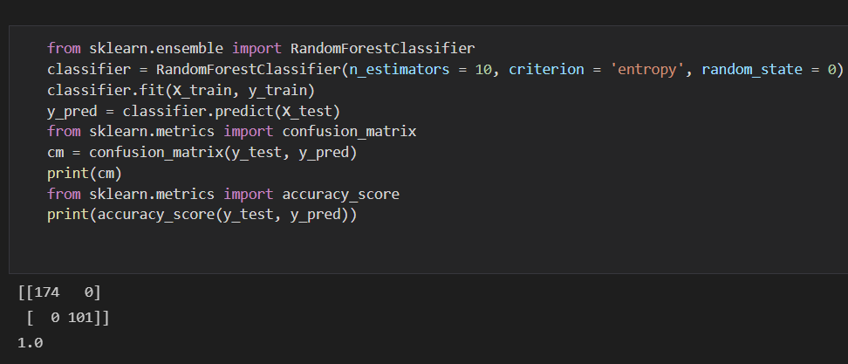
KNN
Logistic regression
SVC
DecisionTreeClassifer
Random forest Classifer
Logistic regression

Slide 9
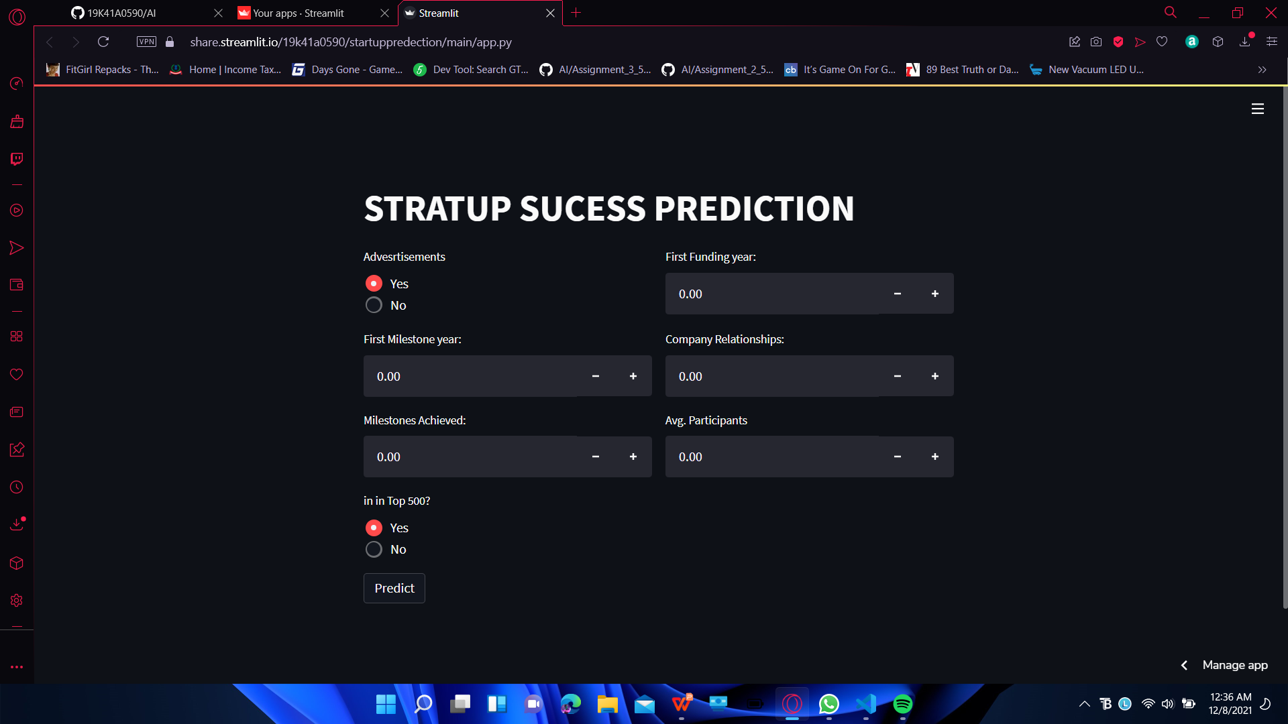
Application Demonstration

Slide 10
Future Scope.
Real time data
Re evaluvate
Collecting the real time funding and investment collection.
Re check the project for bugs and precesion and re train for better results
Ideation
Creation
Deploy and presentation
New format of ui rate of success display
Making the project based on the real time data.
Make the project gloabal and user freindly .

Slide 11
Ai-Team 15
Thankyou

